Slide 1
Skin Cancer Detection Using Digital Image Processing

Slide 2
CONTENTS
Abstract
Introduction
Existing method
Proposed method
Results
Conclusion
References

Slide 3
ABSTRACT
Detection of skin cancer in the earlier stage is very Important and critical. In recent days, skin cancer is seen as one of the most Hazardous form of the Cancers found in Humans. Skin cancer is found in various types such as Melanoma, Basal and Squamous cell Carcinoma among which Melanoma is the most unpredictable. The detection of Melanoma cancer in early stage can be helpful to cure it. Computer vision can play important role in Medical Image Diagnosis and it has been proved by many existing systems. In this paper, we present a computer aided method for the detection of Melanoma Skin Cancer using Image processing tools. The input to the system is the skin lesion image and then by applying novel image processing techniques, it analyses it to conclude about the presence of skin cancer. The Lesion Image analysis tools checks for the various Melanoma parameters Like Asymmetry, Border, Colour, Diameter, (ABCD) etc. by texture, size and shape analysis for image segmentation and feature stages. The extracted feature parameters are used to classify the image as Normal skin and Melanoma cancer lesion.

Slide 4
INTRODUCTION
In skin health, diagnosis or diagnostics is the process of identifying a skin texture or problem by its signs, symptoms and the result of various diagnosis procedures.
The conclusion reached through this process is called a diagnosis. The diagnosis system is a system that can be used to analyze any problem by answering some questions that lead to a solution to the problem.
Skin cancer is a malignant tumor that grows in the skin cells and accounts for more than 50 percent of all cancers. In the US alone, more than 1 million Americans will be diagnosed in 2007 with non-melanoma skin cancer, and 59, 940 will be diagnosed with melanoma, according to the American Cancer Society.
Fortunately, skin cancers (basal cell and squalors cell carcinoma, and malignant melanoma) are rare in children.

Slide 5
When melanomas occur, they usually arise from pigmented nevi (moles) that are large (diameter greater than 6 mm), asymmetric, with irregular borders and coloration.
Bleeding, itching, and a mass under the skin are other signs of cancerous change. If a child has had radiation treatment for cancer, nevi in the radiated area are at increased risk of becoming cancerous

Slide 6
EXISTING METHOD
Image Acquisition
Image acquisition Dermoscopic images are basically digital photographs/images of magnified skin lesion, taken with conventional camera equipped with special lens extension. The lens attached to the dermatoscope acts like a microscope magnifier with its own light source that illuminates the skin surface evenly.
Image Preprocessing
Image pre-processing before analysis of any image set can take place, preprocessing should be performed on all the images. This process is applied in order to make sure that all the images are consistent in desired characteristic.
Segmentation Techniques
Threshold Based Segmentation
Clustering Techniques
Edge Detection Based

Slide 7
Feature Extraction
Asymmetry Index :
Asymmetry Index is computed with the following equation: AI=(A1+A2)/2Ar
Border Irregularity :
In order to calculate border irregularity, there are different measures such as:
compactness index, fractal index, edge abruptness.
Color Index :
Color index is calculated by converting the input image to hsv image value by checking the
presence of the following colors.
Diameter :
The diameter value is said to be 5 if the diameter of lesion is greater than 6mm.
TDS Calculation
Following formula is used
TDS = 1.3A + 0.1B + 0.5C + 0.5D
If the TDS Index is less than 4.75, it is benign (noncancerous) skin lesion. If TDS Index is
greater than 4.75 and less than 5.45, it is suspicious case of skin lesion

Slide 8
Advantages:
Skin Cancer Detection System is the system to identify and recognize skin cancer symptoms and diagnose melanoma in early stages
The user can take early prevention of their healthy. Skin Cancer Detection System will help save lots of doctor’s time and could help to diagnose more accurate.
It also can easily assess the future development of skin via dialysis today’s age of the skin and put forward the best characteristic skin cancer project to client.

Slide 9
Drawbacks:
It gives less accuracy and performance is low

Slide 10
PROPOSED METHOD
The input for the system is the image of the skin lesion which is speculated to be a melanoma lesion image, which is then pre- processed to upgrade the image quality. The background subtraction and edge detection are used for image segmentation. The segmented image is then given to the feature extraction block, which inheres of region lesion analysis for its classic geometrical features. The geometrical features are advised since they are the most sophisticated features of the skin cancer lesion. The extracted features are moreover given to the feature classification stage which classifies the skin lesion as cancerous or normal by Neural Network.

Slide 11
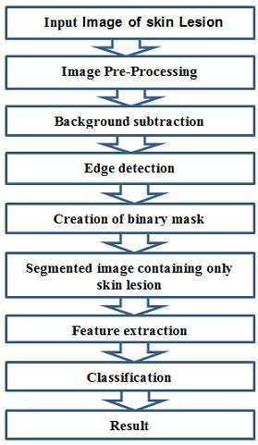

Slide 12
Image Pre-Processing :
Image scaling :Image scaling is the course of action of resizing a digital image. The size of an image is reduced or enlarged, the pixels that form the image become increasingly visible, making the image appear “soft”.
RGB to grayscale image : The rgb2gray function converts the true color image RGB to the grayscale intensity image, by eliminating the saturation information.
Segmentation
Image segmentation is the course of action of segregating an image into multiple parts, which is used to identify objects or other relevant information in digital images.
1. Background subtraction
Background subtraction, also known as blob detection, is an emerging technique in the fields of image processing wherein an image’s foreground is extracted for further processing. Typically, an image’s regions of interest are objects in its foreground.

Slide 13
2. Edge detection: Edge detection is a significant image processing technique for catching the boundaries of objects within images. It works by detecting discontinuities in brightness.
3.Masking :Masking involves setting the pixel values in an image to zero, or some other “background” value. It is used to separate the lesion from the skin image. The masked image obtained contains only the skin lesion.
Feature Extraction :
Area (A): Number of pixels of the lesion
Perimeter (P): Number of contour pixel
Major Axis Length (Ma L): The length of the line passing through lesion centroid and
joining the two farthest boundary points.
Minor Axis Length (Mi L): The length of the line passing through lesion blob centroid and joining the two adjacent boundary points.
Circularity Index (CI): It gives the shape uniformity.

Slide 14
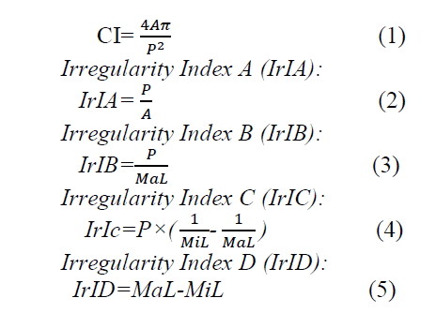
PARAMETERS

Slide 15
Classification:
Using the ABCD rules for the melanoma skin cancer, we use Artificial Neural Network in the classification stage. The construction of the neural network prevails in three distinctive layers with feed forward architecture . It is the most influential network architecture in use today. The input layer of the neural network is a set of the feature values extracted in the feature extraction stage. The input units (neurons) are entirely coupled to the hidden layer with the hidden units. The hidden units (neurons) are also completely linked to the output layer. The output layer delivers the response of the neural network to the activation pattern implemented to the input layer. The single output from the system denotes whether the input skin contains cancer or not. The information given to a neural network is procreated layer-by-layer from the input layer to output layer through (none) one or more hidden layers.

Slide 16
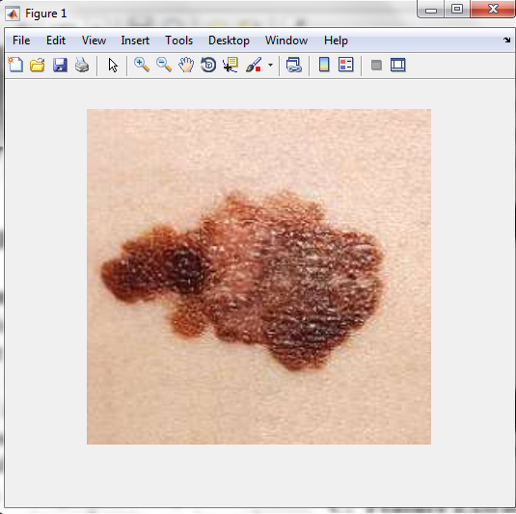
RESULTS

Slide 17
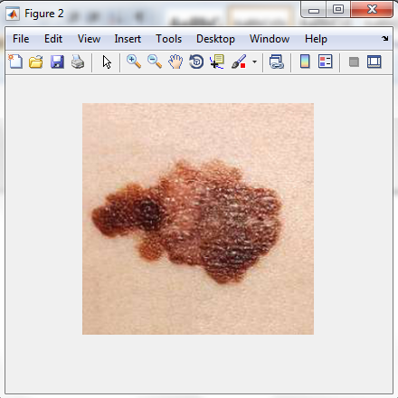
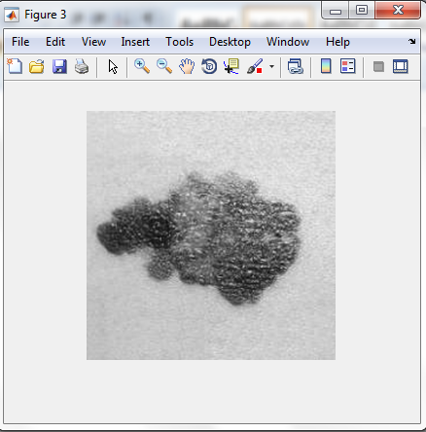

Slide 18
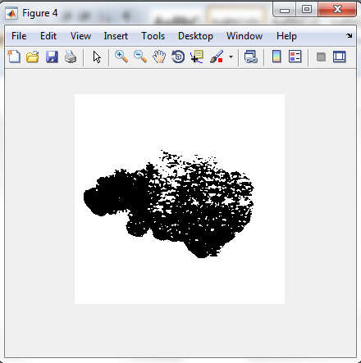
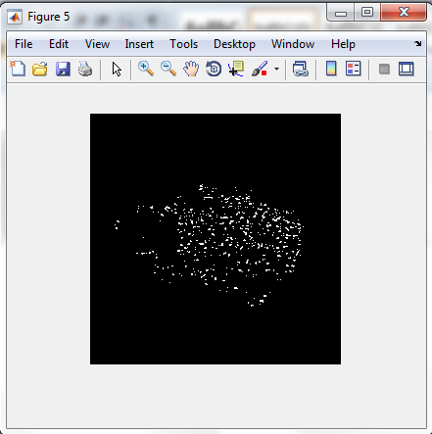

Slide 19
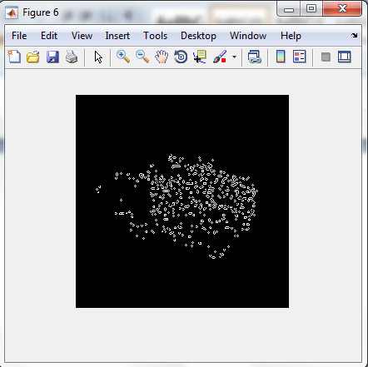
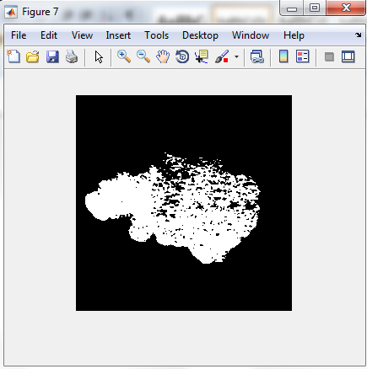

Slide 20
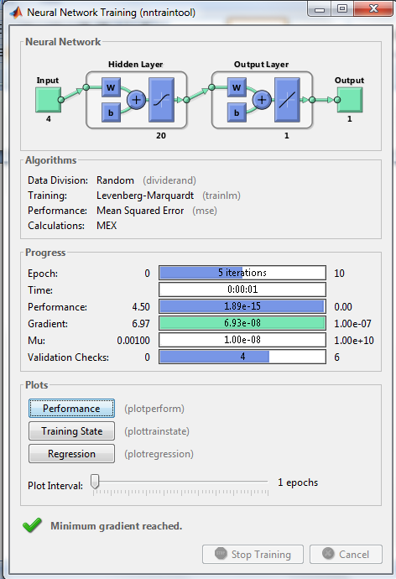

Slide 21
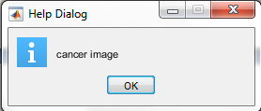


Slide 22
CONCLUSION
Incident rates of melanoma skin cancer have been rising since last two decades. So, early, fast and effective detection of skin cancer is paramount importance. If detected at an early stage, skin has one of the highest cure rates, and the most cases, the treatment is quite simple and involves excision of the lesion.
Moreover, at an early stage, skin cancer is very economical to treat, while at a late stage, cancerous lesions usually result in near fatal consequences and extremely high costs associated with the necessary treatments.
After all, the best way to lower the risk of melanoma is to limit the exposure to strong sunlight and other source of Ultraviolet light. Take care of all the necessary measures such as: protecting skin with clothing, wearing hat, using sunscreen, staying in the shade (etc.).

Slide 23
REFERENCES
[1] Nilkamal S. Ramteke and Shweta V. Jain, ABCD rule based automatic computer-aided skin cancer detection using MATLAB, Nilkamal S Ramteke et al, Int.J.Computer Technology and Applications, Vol 4 (4), 691-697.
[2] Md.Amran Hossen Bhuiyan, Ibrahim Azad, Md.Kamal Uddin, Image Processing for Skin Cancer Features Extraction, International Journal of Scientific and Engineering Research Volume 4, Issue 2, February-2013 ISSN 2229-5518
[3] Maciej Ogorzaek, Leszek Nowak, Grzegorz Surowka and Ana Alekseenko, Modern Techniques for Computer-Aided Melanoma Diagnosis, Jagiellonian University Faculty of Physics, Astronomy and Applied Computer Science Jagiellonian University Dermatology Clinic, Collegium Medicum Poland.
[4] Leszek A. Nowak, Maciej J. Ogorzaek, Marcin P. Pawowski, Texture Analysis for Dermoscopic Image Processing, Faculty of Physics, Astronomy and Applied Computer Science Jagiellonian University Krakw, Poland.
[5] G. GRAMMATIKOPOULOS, A. HATZIGAIDAS, A. PAPASTERGIOU, P. LAZARIDIS, Z. ZAHARIS, D. KAMPITAKI, G. TRYFON, Automated Malignant Melanoma Detection Using MATLAB, Proceedings of the 5th WSEAS Int. Conf. on DATA NETWORKS, COMMUNICATIONS and COMPUTERS, Bucharest, Romania, October 16-17, 2006.

